Slide 1
Bystander Intervention Programming
Welcome, Eagles!

Slide 2
Bystander Intervention Program
Welcome!

Slide 3
Bystander Intervention Program
Reinhardt University’s Vision
Mission
and
Values

Slide 4
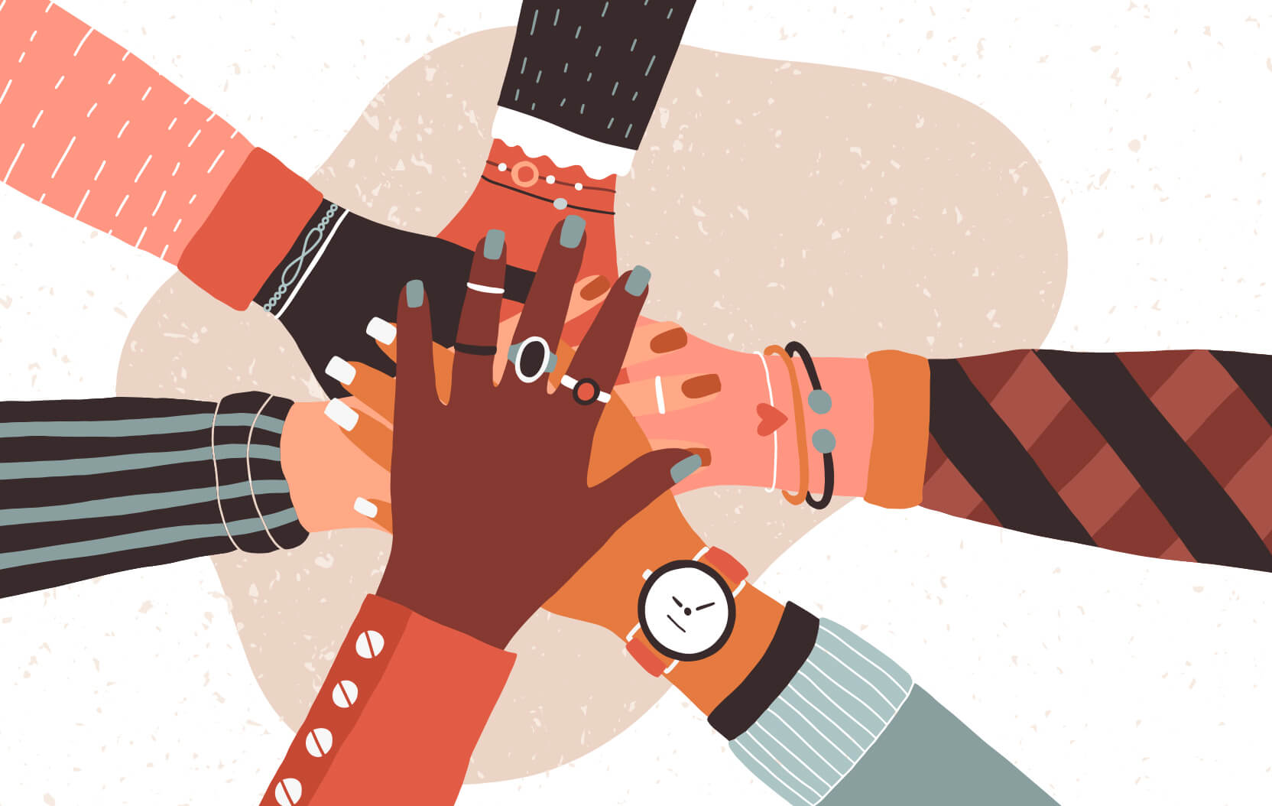
Bystander Intervention Program
Are you an
ally?
“To be an ally is to… stand up, even if you feel scared.”
-Amelle Lamont

Slide 5
Bystander Intervention Program
Some of the topics we discuss today may be difficult for some viewers.

Slide 6
Bystander Intervention Program
What is the
Bystander Effect?
An occurrence in which people fail to offer needed help in emergencies, especially when other people are present in the same setting.

Slide 7
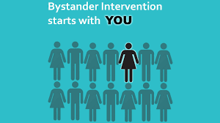
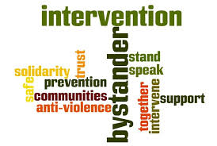
Bystander Intervention Program
What is
Bystander Intervention?
Bystander intervention is safe and positive options that are carried out by those surrounding the situation to prevent harm or intervene when there is a risk of sexual harassment, sexual assault, dating violence, domestic violence or stalking.

Slide 8
Bystander Intervention Program
Making a Connection:
Activity

Slide 9
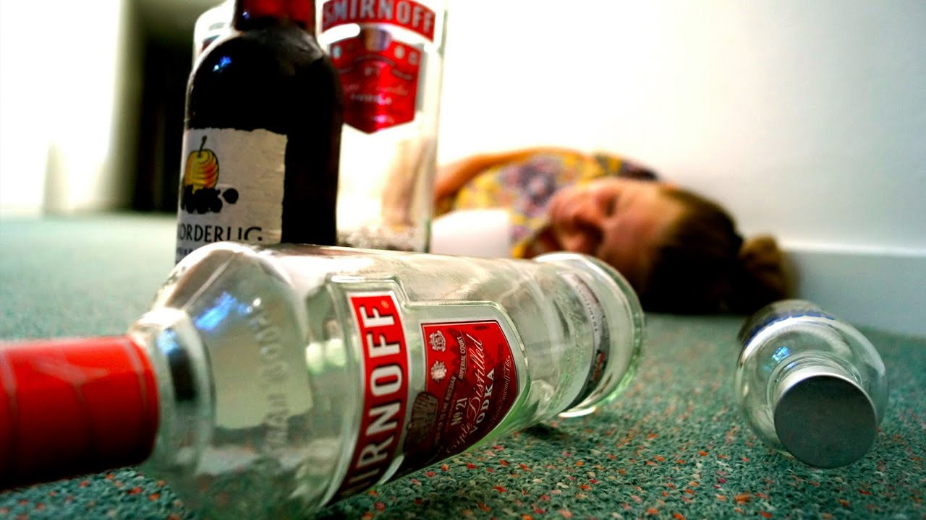
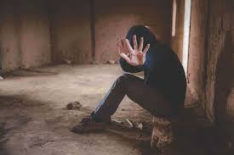
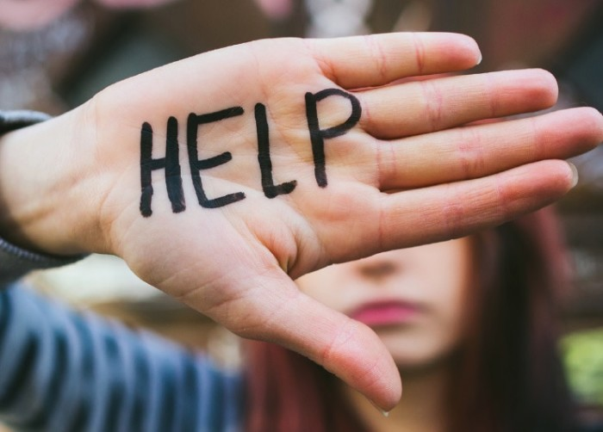
Bystander Intervention Program
Identifying Risk and Recognizing Warning Signs:
Risks
Warning Signs

Slide 10
Bystander Intervention Program
Important
Definitions

Slide 11
Bystander Intervention Program
Domestic
& Dating Violence

Slide 12
Bystander Intervention Program
Sexual Assault

Slide 13
Bystander Intervention Program
Stalking

Slide 14
Bystander Intervention Program
Are you a
bystander?
“What hurts the victim most is not the cruelty of the oppressor, but the silence of the bystander.”
-Ellie Wiesel

Slide 15
Bystander Intervention Program
Activity
Acknowledging Barriers to Action
Not understanding the warning signs
Believing it is not your role or responsibility
Not knowing what to do
Fear of doing the wrong thing or being embarrassed

Slide 16
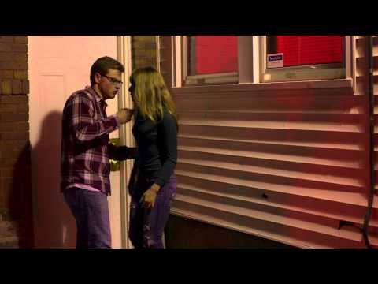
Bystander Intervention Program
Who will YOU be?
https://www.youtube.com/watch?v=shuuTOMCKZ8

Slide 17
Bystander Intervention Program
The four D’s of
Bystander Intervention
Direct
Speak directly to those involved
Distract
Create a distraction or a way out
Delegate
Seek out help from someone who’s qualified
Delay
Follow-up with the victim afterward

Slide 18
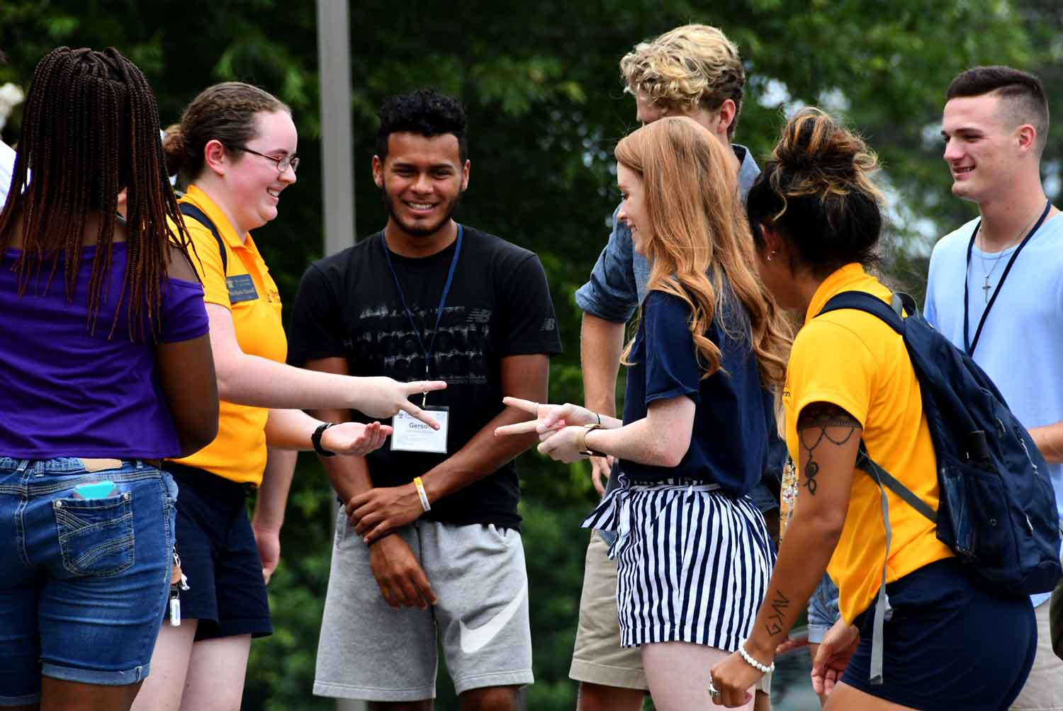
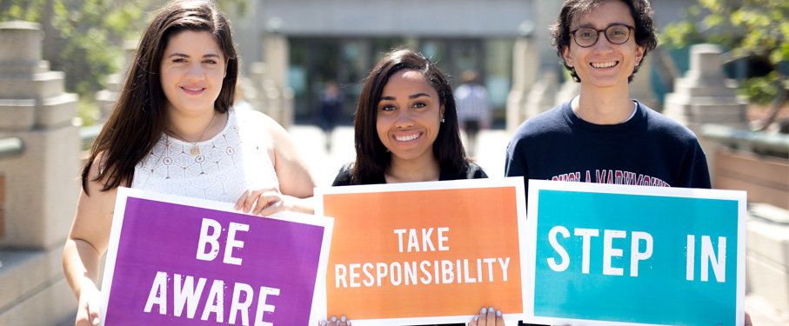
Bystander Intervention Program
BE
PROACTIVE!

Slide 19
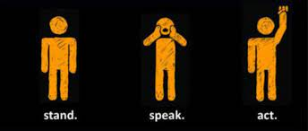
Bystander Intervention Program
Proactive Behaviors
PROVIDE OPTIONS and a listening ear to someone who is in an emergency situation .
EDUCATE others on interpersonal/dating violence and gender inequality.
POST BYSTANDER STORIES on social media
MAKE A COMMITEMENT on campus to practice bystander intervention.

Slide 20
Bystander Intervention Program
THANK YOU!
This project was supported by Grant No. 2020-WA-AX-0022 awarded by the Office on Violence Against Women, U.S. Department of Justice. The opinions, findings, conclusions, and recommendations contained expressed in this publication/program/exhibition are those of the author(s) and do not necessarily reflect the views of the Department of Justice, Office on Violence Against Women.

